Slide 1

Team Nourish
Identifying eating and drinking patterns from audio
Florian Rumpold
Lucas Pawlak
Maarten de Jonge

Slide 2
Table of contents
Introduction Project Teddy
Our objective
Research question
Our models
Next (final) steps

Slide 3
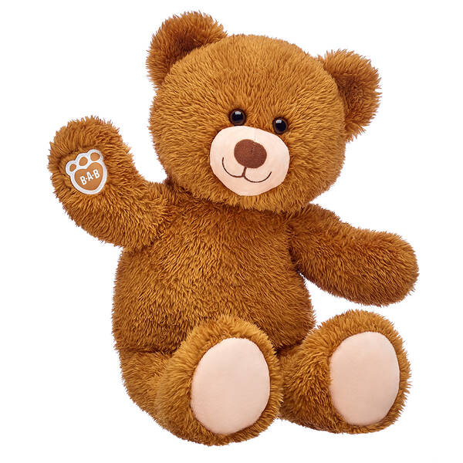
Introduction to Project Teddy
Dementia patients living alone
Teddy with sensors
Assess Quality of Life

Slide 4
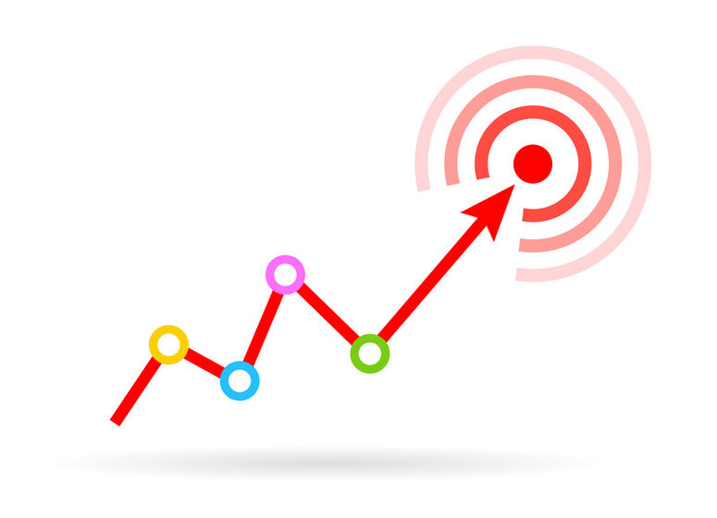
Our objective
Detecting eating and drinking sounds
Detect if the patient is eating and drinking on a regular basis

Slide 5
Research Question
Which deep learning model has the highest precision to detect eating and drinking sounds?

Slide 6
Old Models
Machine learning (LinRegress, K-Nearest Neighbor)
manual feature engineering
Linear Neural networks
low accuracy and precision
Greatly overfitting
Adding Convolution steps
Adjusting hyperparameters

Slide 7
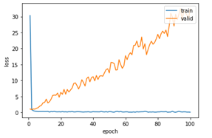
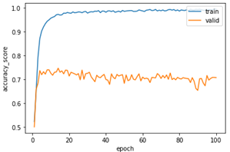
Loss & Accuracy of old model

Slide 8
New Models
Implemented different ResNet Models
Increased accuracy score but the max is 0.80 on Validation Set
Fluctuating Validation Loss
Trying binary classifiers
No significant improvements

Slide 9
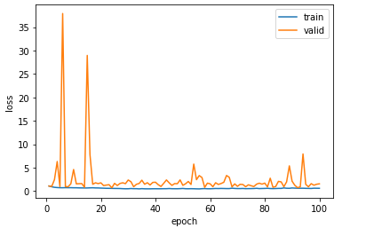
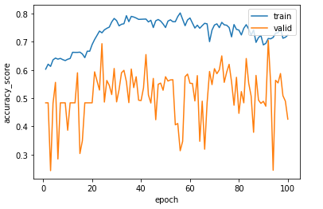
Loss & Accuracy ResNet Models

Slide 10
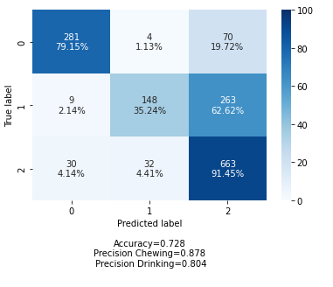
Best Score Validation set

Slide 11
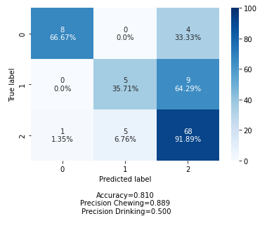
Best Score Test set

Slide 12
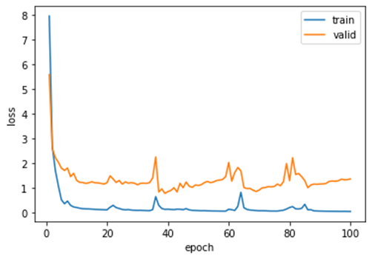
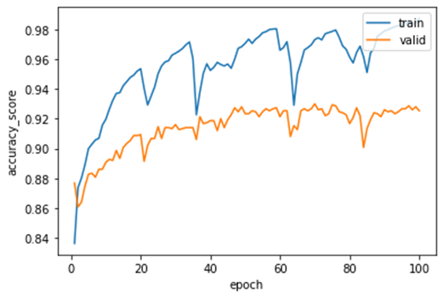
Loss & Accuracy Binary Models

Slide 13
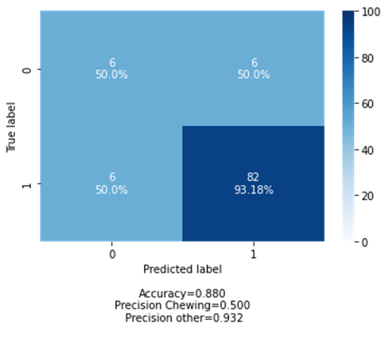
Confusion Matrix Binary model

Slide 14
Next steps
Almost no more programming
Slight tuning
Finishing model for problem owner
Research paper
Personal portfolios and test

Slide 15
Questions, Feedback & Advice are very welcome!

